Slide 1
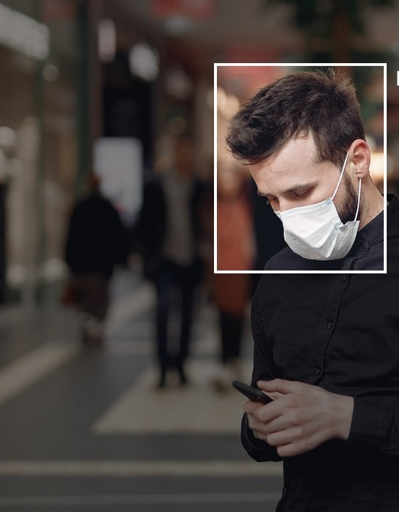
Face Mask Detection System Using AI and ML
Yuvraj Passi
Shobhit Jain
Shubhang Singh

Slide 2
Agenda
1
2
3
4
5
Introduction
Methodology
Model
Architecture
Model
Training
Results

Slide 3
Introduction
The COVID-19 pandemic fundamentally changed the way we interacted in public spaces, making face masks a critical component of public health. Enforcing the usage of masks, especially in crowded areas, is essential to prevent any virus transmission​.
Manual monitoring, however, is time-consuming and inefficient. This project addresses the challenge by introducing an automated, AI-powered face mask detection system that can monitor compliance in real-time.

Slide 4
Related Work
Several studies and projects have explored the use of computer vision for face detection and classification. Most notably, advancements in deep learning, particularly using CNNs, have made it possible to achieve high accuracy in image classification tasks.
This project focuses on a custom-trained CNN model optimized for face mask detection. Unlike previous solutions, this project integrates real-time video stream analysis, making it more suitable for practical, real-world applications like surveillance in public places.

Slide 5
Methodology
Data Collection and Preprocessing: Dataset: The dataset used for training the model consists of images categorized into two classes: "With Mask" and "Without Mask".
Data Augmentation: To enhance model performance and prevent overfitting, data augmentation techniques such as rotation, flipping, and scaling were applied.
Image Preprocessing: Images are resized to 128x128 pixels, converted to RGB, and normalized for optimal model training.

Slide 6
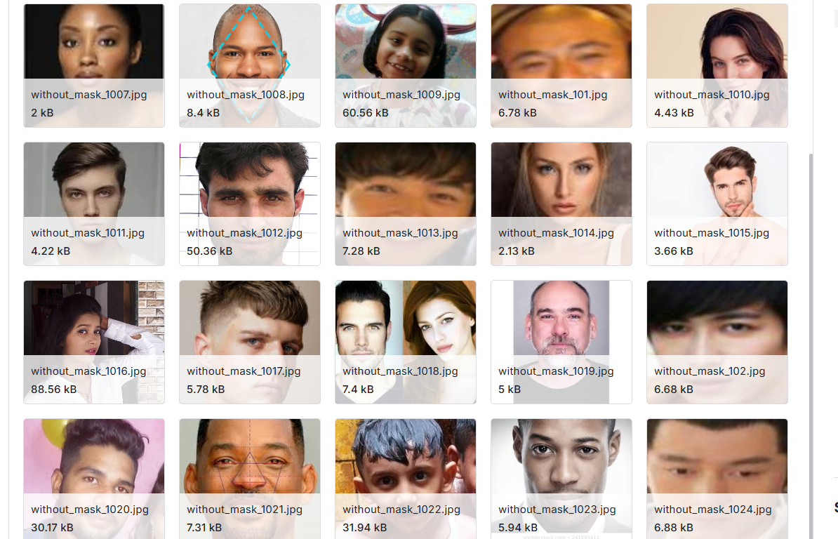
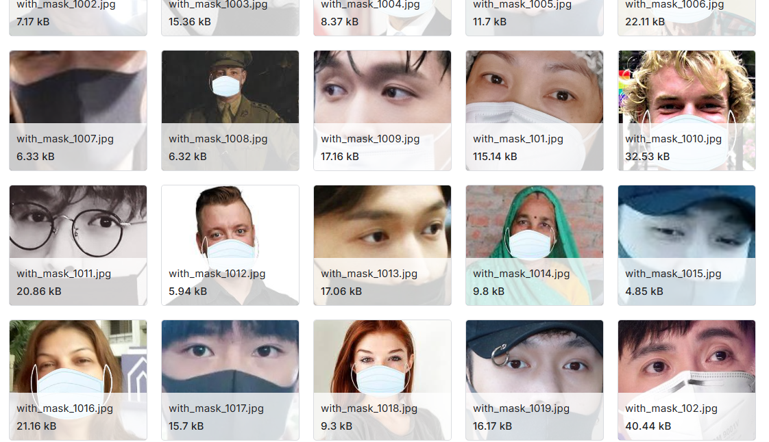
A Few Snippets
Dataset:

Slide 7
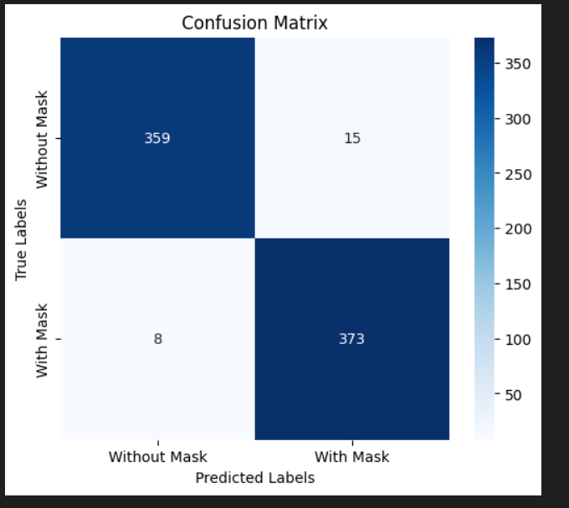
Confusion Matrix

Slide 8
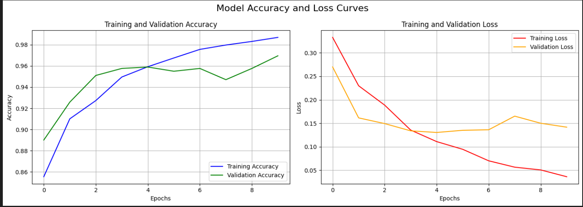
Model Accuracy

Slide 9
Model Architecture
Convolutional Neural Network (CNN): The model is a custom-built CNN designed to detect face masks in real-time. The architecture includes:
Input Layer: Accepts images of size 128x128x3.
Convolutional Layers: Multiple layers with ReLU activation to extract features
Pooling Layers: MaxPooling layers to reduce spatial dimensions.
Dense Layers: Fully connected layers leading to a binary classification output.
Output Layer: Sigmoid activation function for binary classification ("With Mask" or "Without Mask").

Slide 10
Model Training and Evaluation
Training: The model was trained using the Adam optimizer with a learning rate of 0.001, and binary cross-entropy as the loss function.
Evaluation Metrics: Accuracy, precision, recall, and F1-score were used to evaluate the model's performance on the test set.
Real-Time Detection: OpenCV was utilized for capturing live video feed and detecting faces using the Haar Cascade Classifier. The trained model was then applied to classify detected faces.

Slide 11
Live Video Stream Integration
Webcam Integration: The system uses OpenCV to access the webcam for real-time mask detection.
User Interface: The detected faces are highlighted with bounding boxes, and the classification result ("With Mask" or "Without Mask") is displayed on the video feed.

Slide 12
Experiment Results
Training Accuracy: Achieved 98% accuracy on the training dataset.
Validation Accuracy: Maintained an accuracy of 96% on the validation dataset.
Real-Time Detection Accuracy: Successfully classified mask usage with over 95% accuracy in real-time video feeds. The system was tested under various lighting conditions and angles, demonstrating robust performance in detecting masks.
Sample Output
The system draws a bounding box around the detected face and displays a label indicating "With Mask" or "Without Mask".
The prediction confidence score is also displayed for each detection.

Slide 13

Conclusion
The Face Mask Detection System developed in this project provides a reliable and efficient solution for monitoring mask compliance in real-time. The system's high accuracy and responsiveness make it suitable for deployment in public spaces to ensure health safety. By leveraging deep learning techniques and real-time video analysis, this project offers a scalable approach to automated surveillance

Slide 14

Any Questions?

